Slide 1



Department of Statistics and Actuarial Science (SAAS)
School of Computing and Data Science (SCDS)
The University of Hong Kong (HKU)

Slide 2
Course Selection

Slide 3
2026-2027 Course Selection Schedule for Full-Time Undergraduate Students
 |  | Year 1 students
First Semester Course Selection Period | Online course information available for planning your courses (preview the available courses) | From Aug 2026 (after master registration)
 | Course Selection Period starts | Aug 18, 2026 (10:00 a.m.) - Semester 1/full-year courses Aug 18, 2026 (10:10 a.m.) - Semester 2 courses
 | Suspension Period (course selection will not be available) | Aug 19, 2026 (12:00 noon) – Aug 21, 2026 (2:29 p.m.)
 | Course Selection Period ends | Aug 24, 2026 (4:00 p.m.)

Slide 4
2026-2027 Add/Drop period for Full-Time Undergraduate Students
 |  | Year 1 students
First Semester Add/Drop Period | Add/Drop Period starts (Note: You must finish enrolling the Semester 1/full-year courses before the Semester 2 courses) | Sep 1, 2026 (10:00 a.m.)
 | Suspension Period (course selection will not be available) | Sep 2, 2026 (12:00 noon – 4:59 p.m.)
 | Add/Drop Period ends | Sep 15, 2026 (4:00 p.m.)
Second Semester Add/Drop Period (students should also select summer semester courses (if any) during this period) | Add/Drop Period starts | Jan 18, 2027 (10:00 a.m.)
 | Note: You must finish enrolling the Semester 2 courses before the Summer Semester courses
 | Suspension Period (course selection will not be available) | Jan 19, 2027 (12:00 noon – 4:59 p.m.)
 | Add/Drop Period ends | Feb 1, 2027 (4:00 p.m.)
Summer Semester Add/Drop Period | Add/Drop Period starts | Jun 14, 2027 (10:00 a.m.)
 | Suspension Period (course selection will not be available) | Jun 15, 2027 (12:00 noon – 4:59 p.m.)
 | Add/Drop Period ends | Jun 21, 2027 (4:00 p.m.)

Slide 5
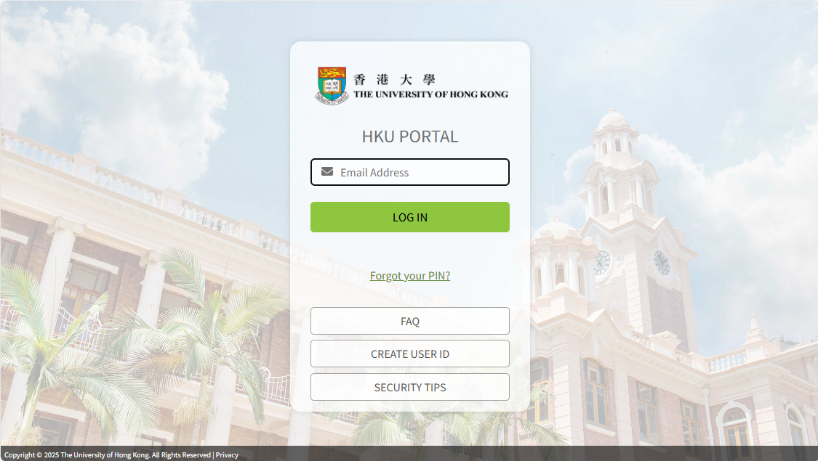
SIS Course Selection System
Guide to students:
https://aas.hku.hk/course-enrollment/
Login to your HKU Portal account (https://hkuportal.hku.hk/cas/aad)

Slide 6
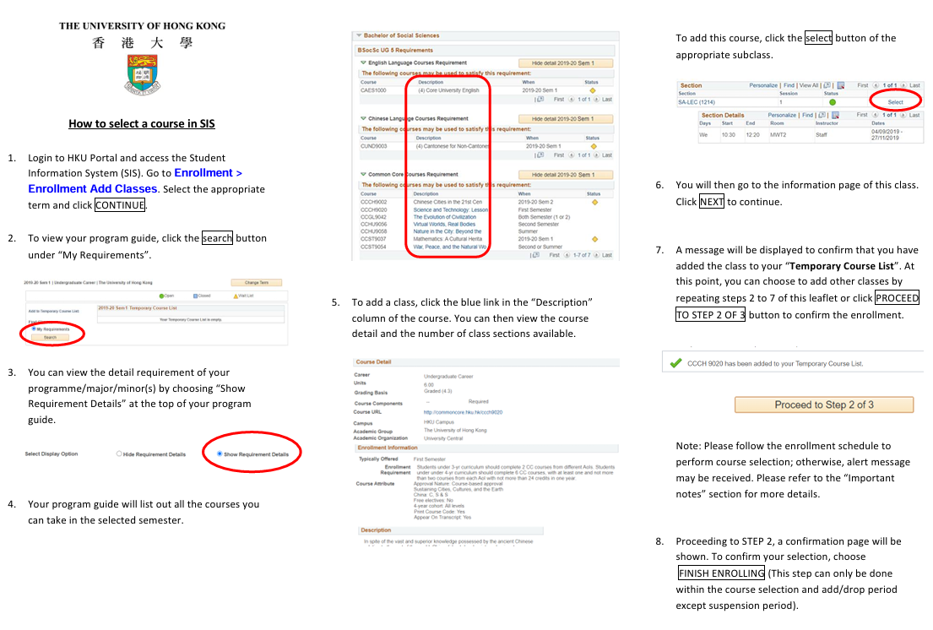
Guide to students:
https://aas.hku.hk/course-enrollment/

Slide 7
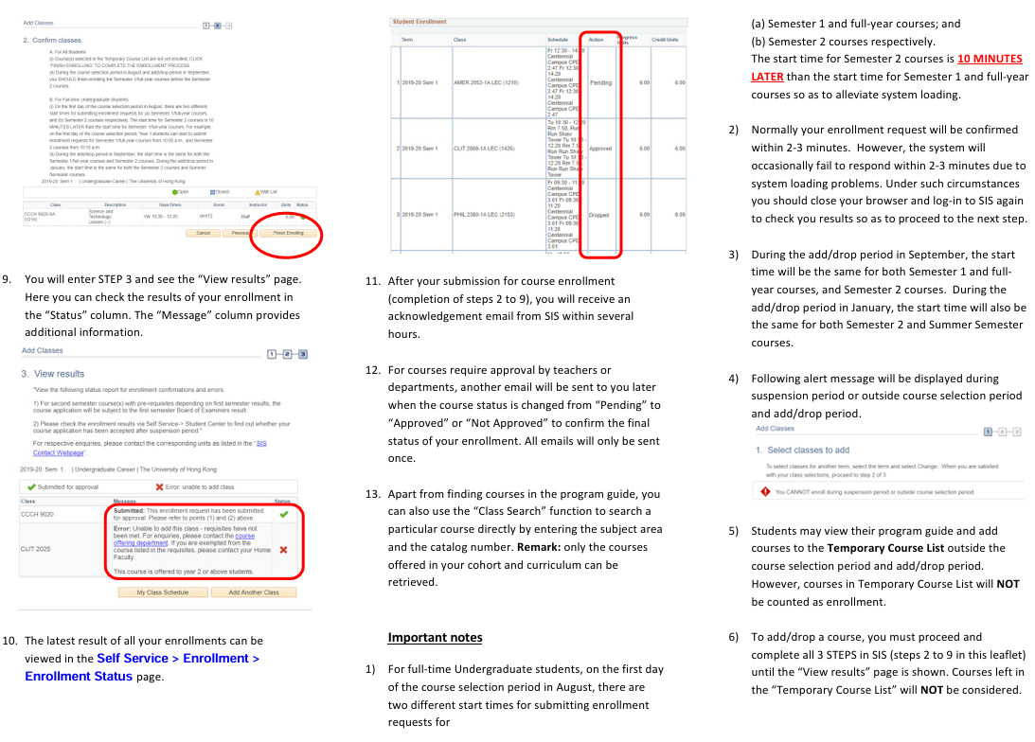

Slide 8
